Slide 1

Indie game
Studio of 4 pers.
My top-3 game

Slide 2
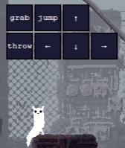

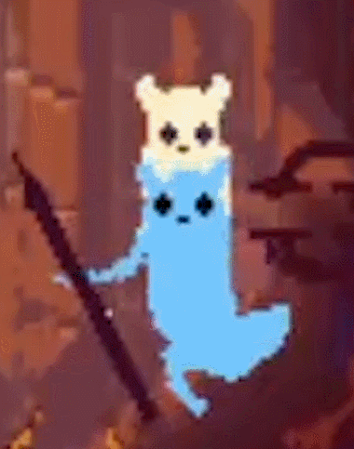
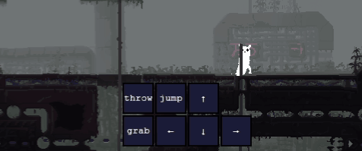
Ur a Slugcat
Limace + Chat

Slide 3
Starting…
Searching
Rain drop
Fall
Separation
Lost
Wander

Slide 4
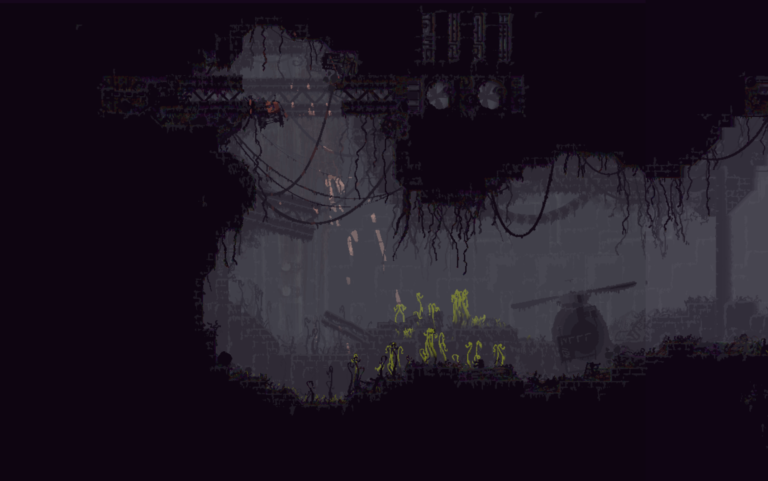
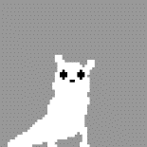

Slide 5
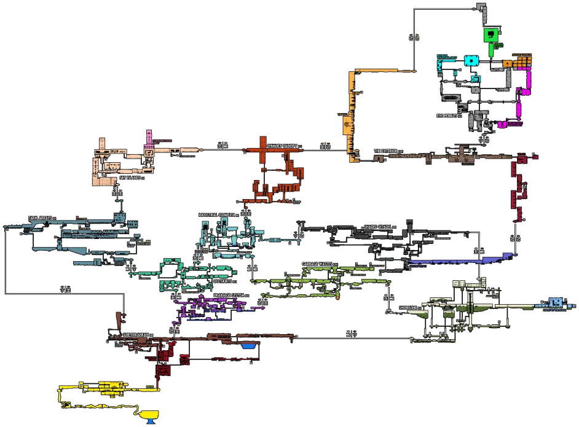
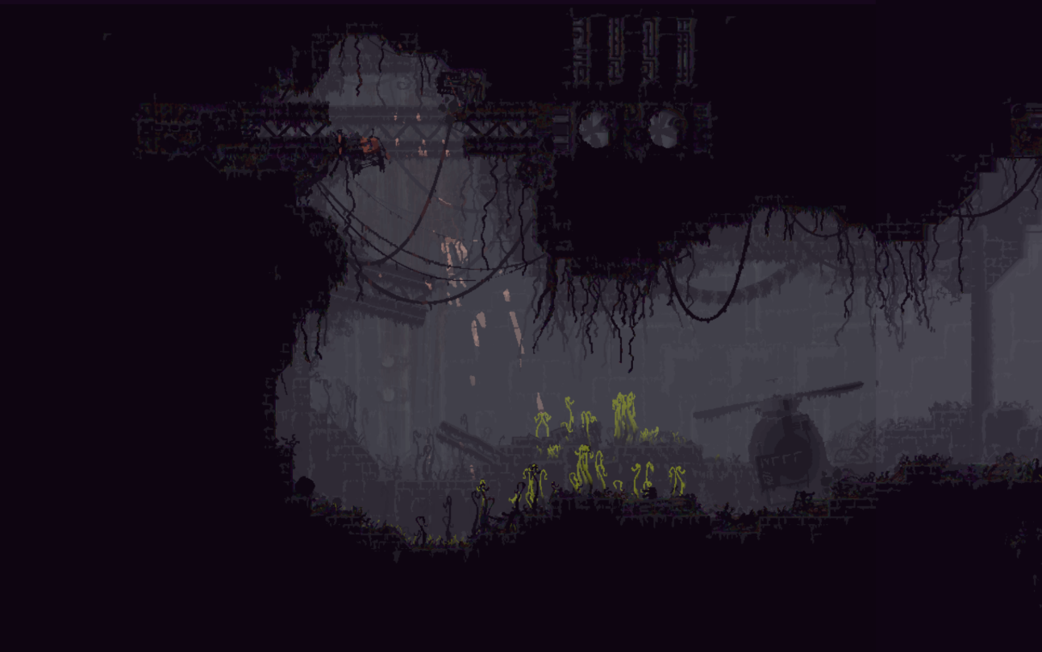

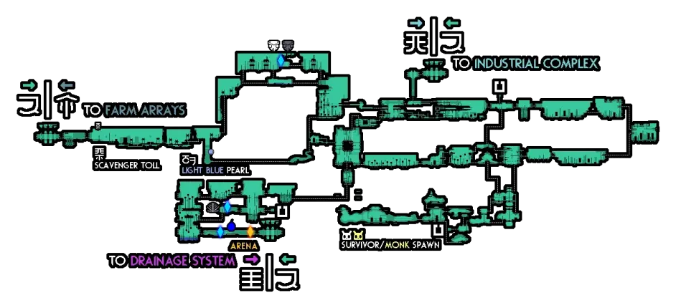
No purpose
No experience
No knowledge
No guide
…

Slide 6
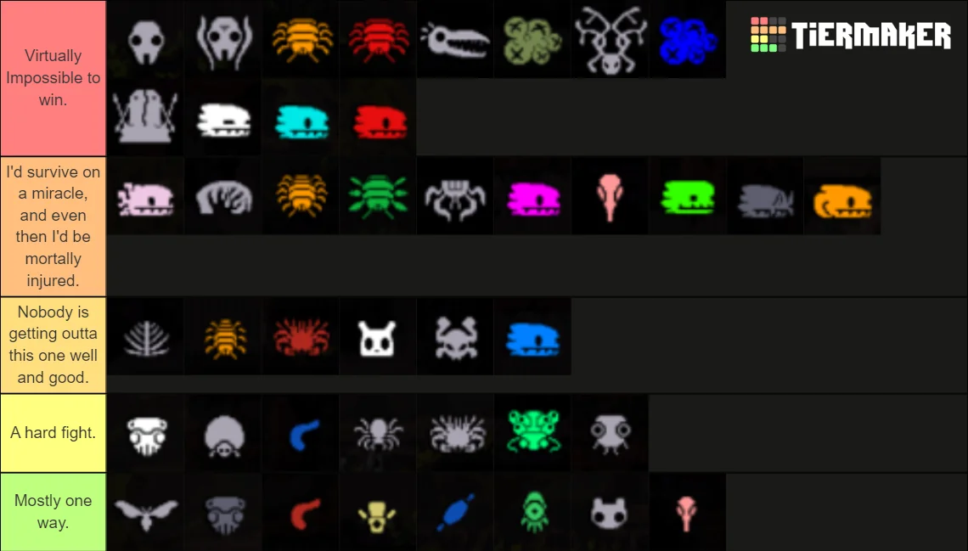
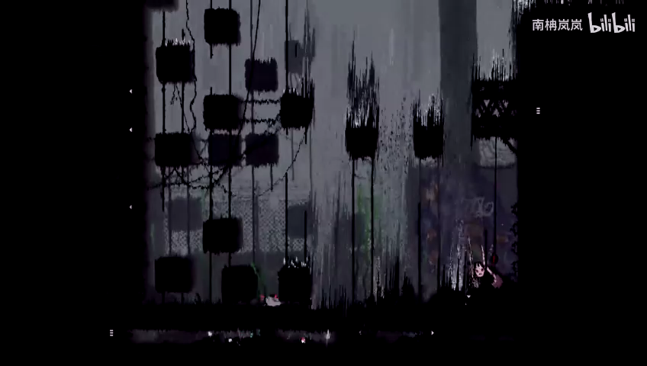
Vulnerable creature in the crucial ecosystem😱
And the rain…🥶
Ur at the bottom as a newbie

Slide 7

So, Why ???

Slide 8
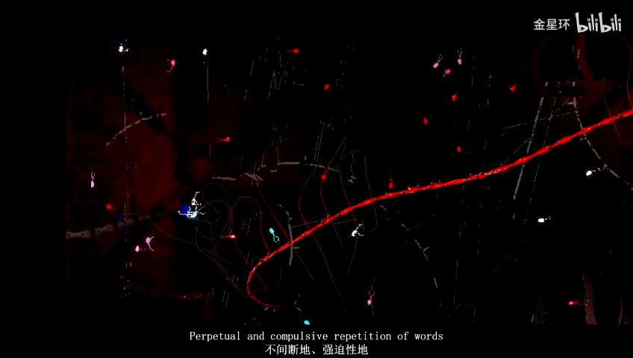
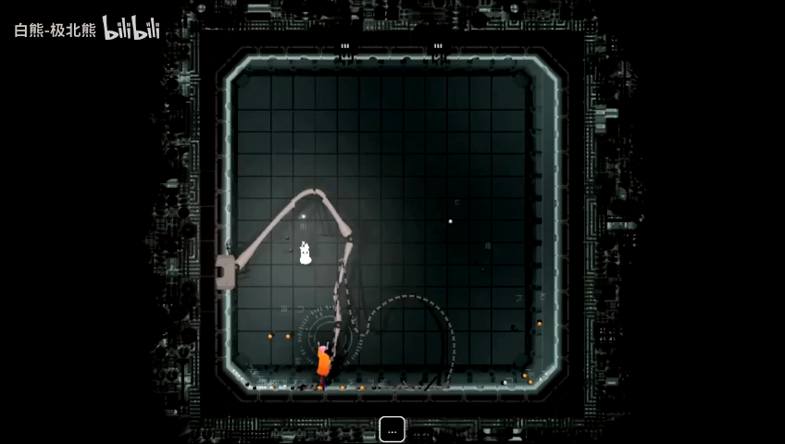
Because…
And more
…

Slide 9
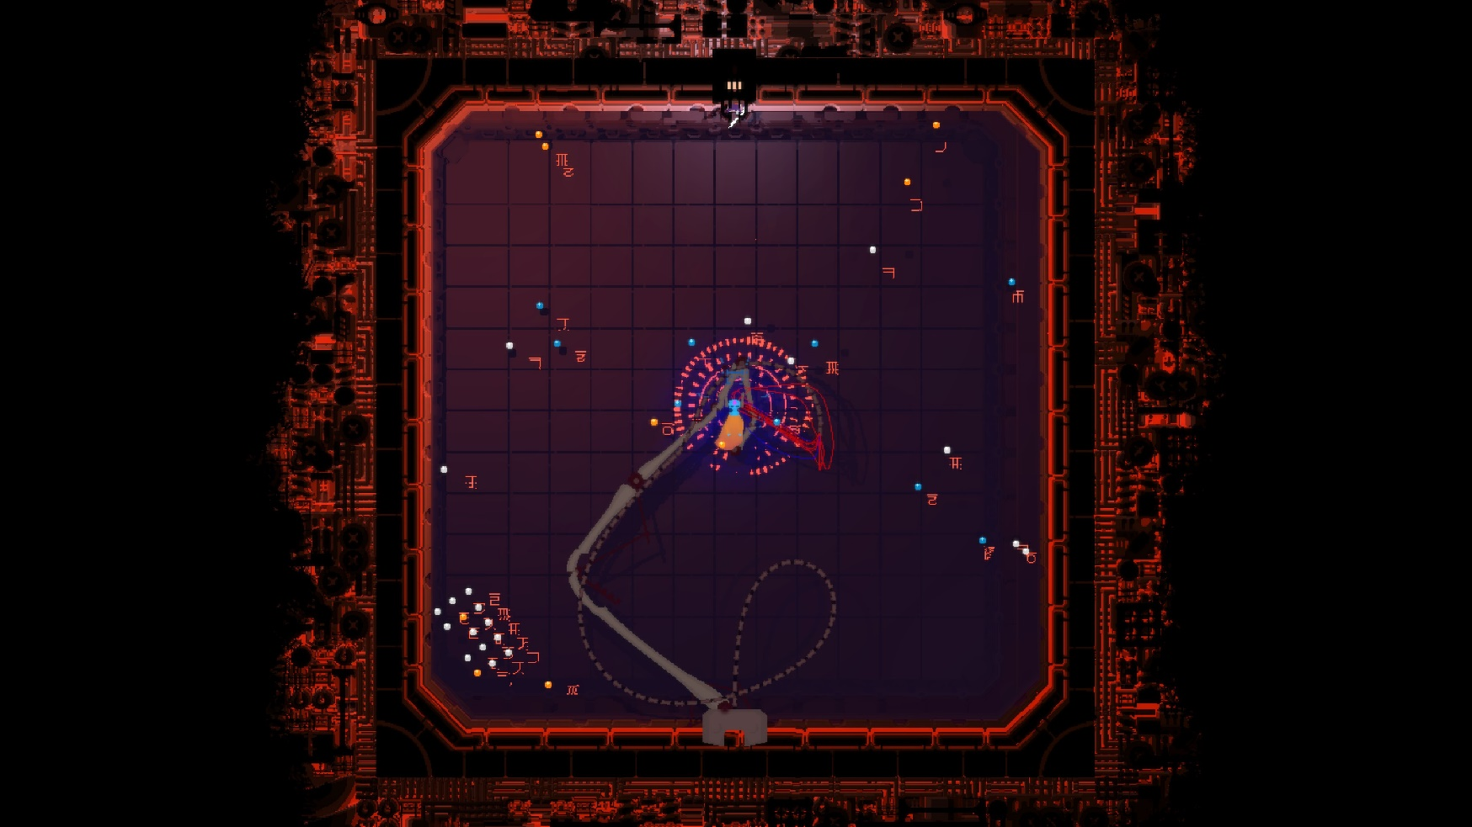
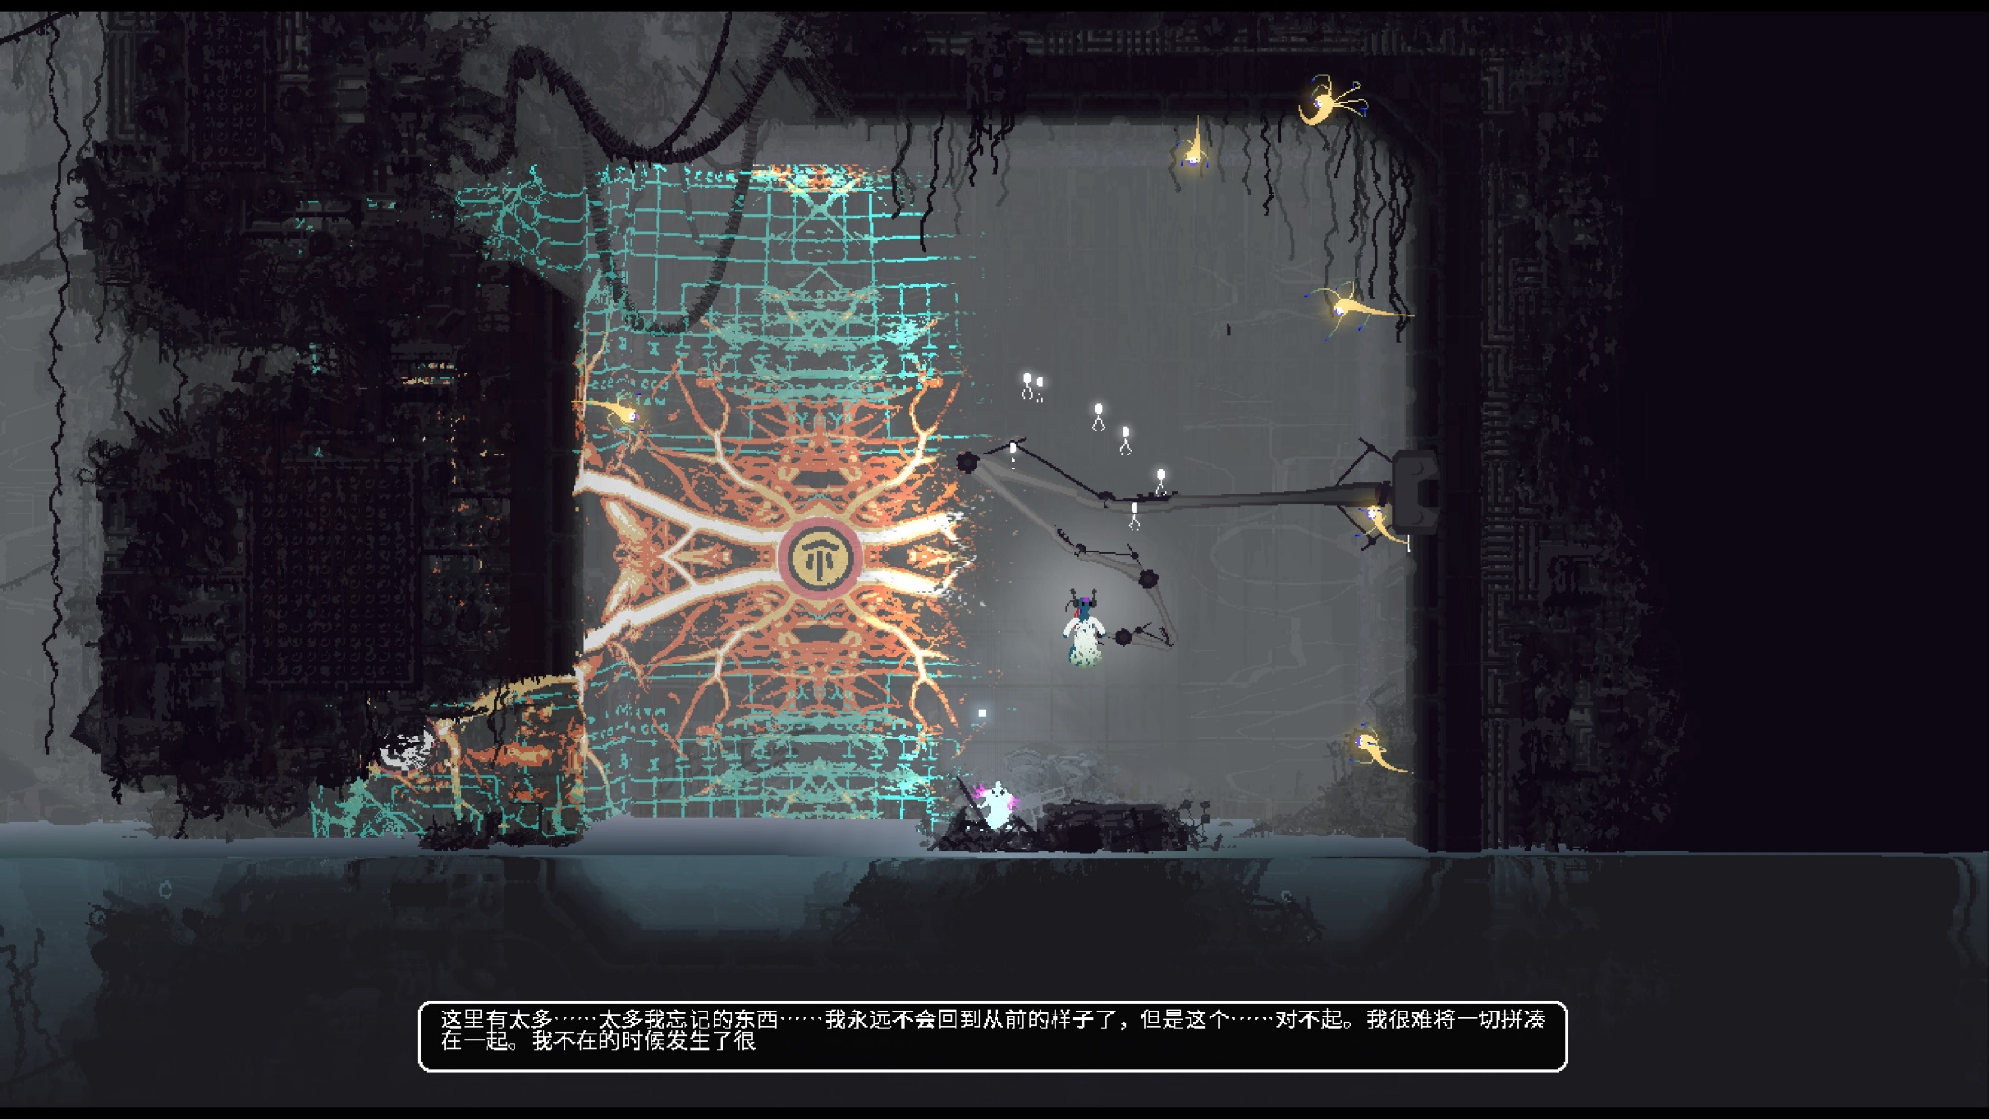
No purpose
No experience
No knowledge
No guide
…
Utill…
No purpose
No experience
No knowledge
No guide
…
Unexcepted shocking ending

Slide 10
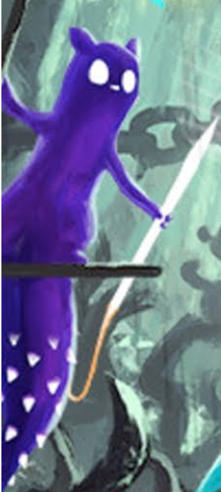
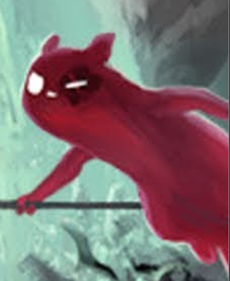
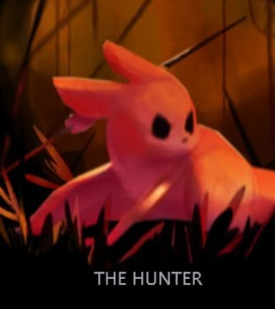
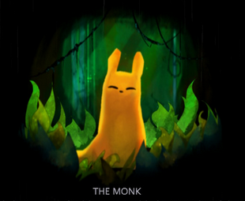



And more and more and more…
From the beginning of the time ☺

